Slide 1
[Track A]
ChainFact: A Decentralized News Verification Platform
Protecting Society from COVID-19 Fake News Pandemic
Di Sheng Lee (MIT), Tugsbayasgalan Manlaibaatar (MIT), Jothi Arul Prakash, Yoke Keng Ngeow, Tay Loong Lai, Chun Kee Yap, Yon Sheng Lim, Guo Ren Mong

Slide 2
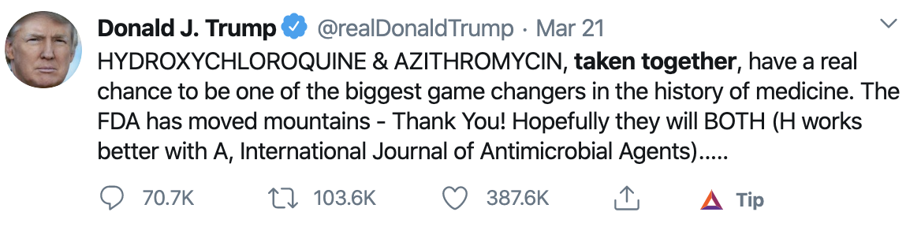
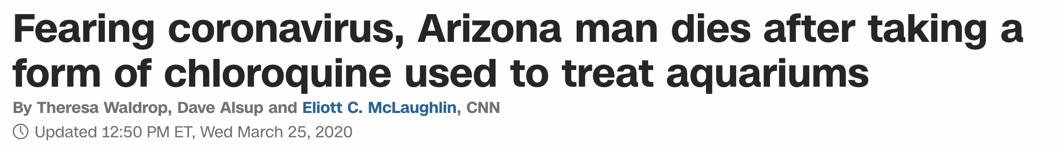
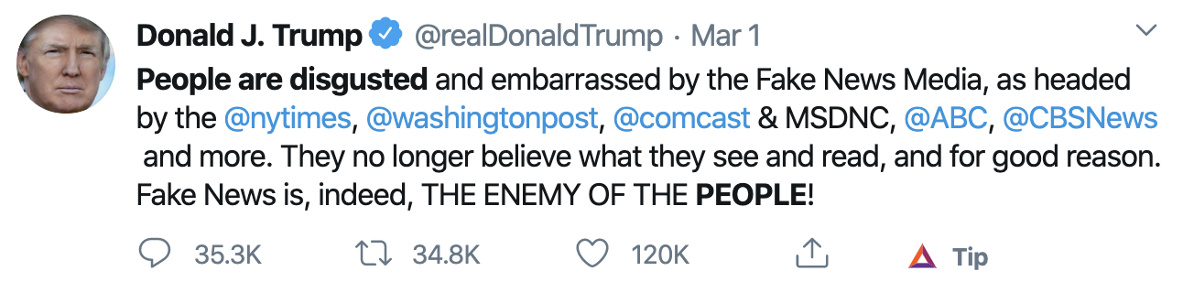
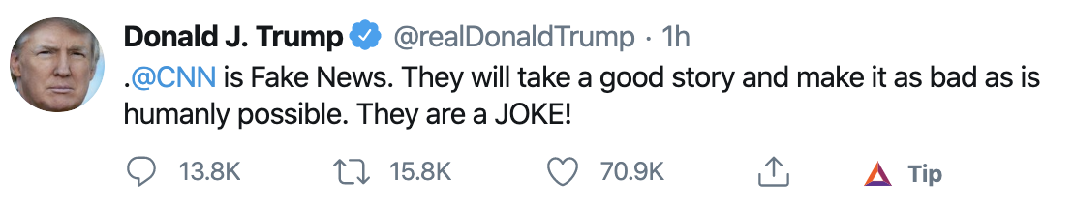
COVID-19 Fake News Pandemic
COVID-19 fake news pandemic is as deadly as the virus itself.
Fake news are 70% more likely to be shared than real ones.
Media credibility all-time-low.

Slide 3
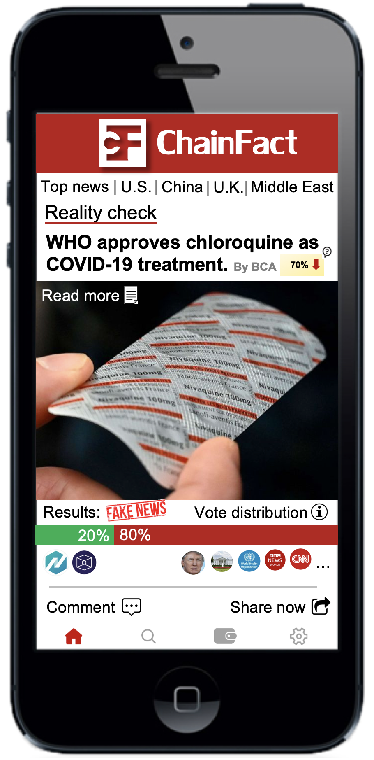
ChainFact App
A democratic voting system for organizations to vote on news accuracy.
Publishing fake news will lower media credibility score.
Reward users with digital $ for engaging with accurate news.
Blockchain-based to guarantee transparency, immutability, and security.

Slide 4

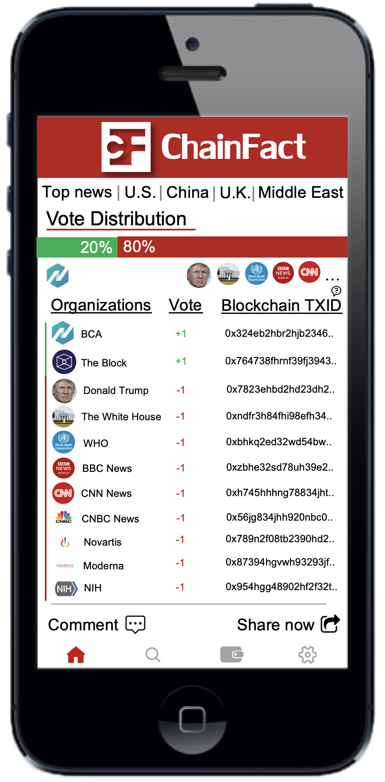

Slide 5
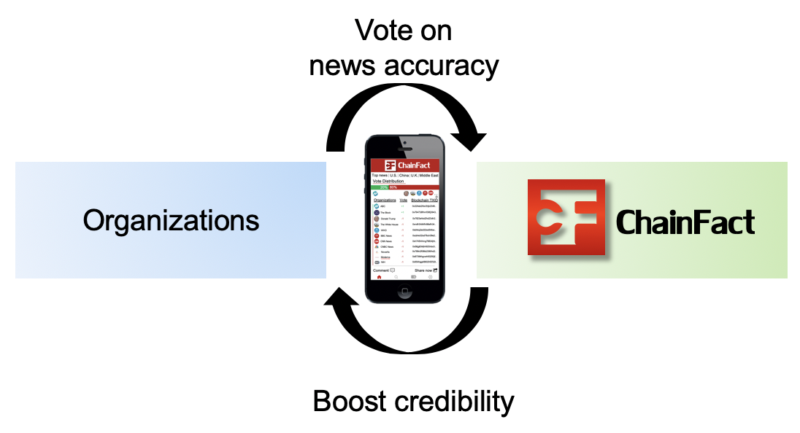
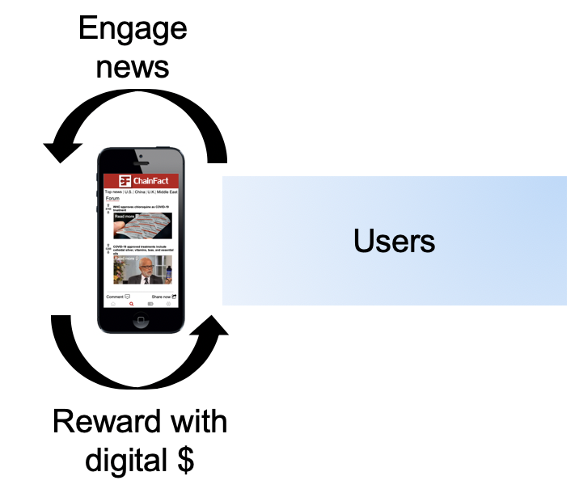
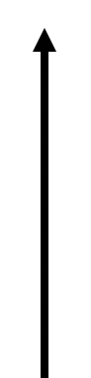
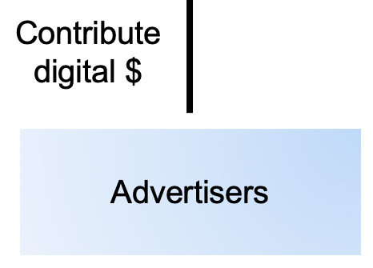
ChainFact Reward Mechanism

Slide 6
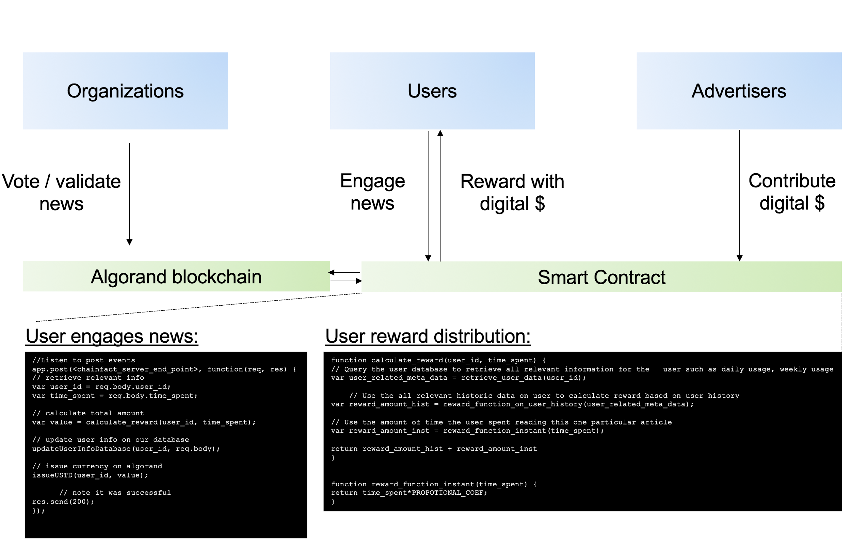

Summary
A decentralized, transparent news verification platform.
Organizations vote on news accuracy: restoring public trust to media.
Users incentivized to engage with accurate news: society protected from COVID-19 fake news pandemic.

